Slide 1
N - GRAMS

Slide 2
Counting Words in Corpora (1)
N-gram model uses the previous N-1 words to predict the next one. An N-gram is an N-token sequence of words.
Such Statistical models of word sequences are also called language models (LMs).
e.g.
all of a sudden I notice three guys standing on the sidewalk…
on guys all I of notice sidewalk three a sudden standing the…..
Statistical processing of natural language is based on corpora (singular corpus)

Slide 3
Counting Words in Corpora (2)
Utterance – sentence of spoken language.
Fragments – words that are broken in the middle.
Word-form – inflected form as it appears in the corpus.
Lemma is a set of lexical forms having the same stem, the same major part-of-speech, and the same word-sense.
Types – Number of distinct words in corpus that is the size of the vocabulary.
Tokens – the total number of running words.

Slide 4
Counting
Simple counting lies at the core of any probabilistic approach.
He stepped out into the hall, was delighted to encounter a water brother.
Not always that simple
  I do uh main- mainly business data processing
Spoken language poses various challenges.
  Should we count “uh” and other fillers as tokens?
  What about the repetition of “mainly”?
  *Answers depend on the application.
  *ASR to support indexing for search, then “uh” isn’t helpful
  *Filled pauses are very useful in dialog management.

Slide 5
Counting: Types and Tokens
  They picnicked by the pool, then lay back on the grass and looked at the stars.
    18 tokens (also counting punctuation)
Note:
“the” is used 3 times, so there are only 16 unique types (as opposed to tokens).
*focus on counting both types and tokens of words and N-grams depending on the application.

Slide 6
Counting: Corpora
Brown et. al. (1992) large corpus of English text
  583 million wordform tokens - 293,181 wordform types
Google
  Crawl of 1,024,908,267,229 English tokens- 13,588,391 wordform types
  *Large dictionaries of English have only around 500k types.
Numbers, Misspellings, Names, Acronyms etc.

Slide 7
Language Modeling
Word prediction
Model the word prediction task as the ability to assess the conditional probability of a word given the previous words in the sequence
  P(w_{n}|w₁,w₂…w_{n-1})
We’ll call a statistical model that can assess this a Language Model

Slide 8
How might we go about calculating such a conditional probability?
  One way is to use the definition of conditional probabilities and look for counts. So to get
  P(the | its water is so transparent that)
By definition that’s
  P(its water is so transparent that the)
  P(its water is so transparent that)
  We can get each of those from counts in a large corpus.

Slide 9
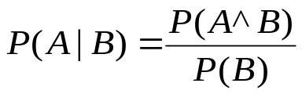


The Chain Rule
Recall the definition of conditional probabilities
Rewriting:
For sequences...
P(A,B,C,D) = P(A)P(B|A)P(C|A,B)P(D|A,B,C)

Slide 10
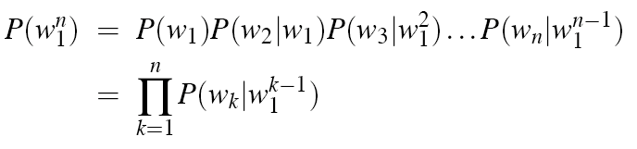
The Chain Rule
P(its water was so transparent)=
P(its)*
P(water|its)*
P(was|its water)*
P(so|its water was)*
P(transparent|its water was so)

Slide 11
Assumption:
Probability of a word depends only on the previous word(s) is called Markov assumption.
Markov models are the class of probabilistic models that assume that predict the probability of some future unit without looking too far into the past.
N-gram looks n-1 words in the past.
A bigram is called a first-order Markov model, a trigram is a second-order Markov model, and an N-gram is a N-1th order Markov model.

Slide 12

Independence Assumption
Make the simplifying assumption
  P(lizard|the,other,day,I,was,walking,alone,and,saw,a) = P(lizard|a)
Or maybe
  P(lizard|the,other,day,I,was,walking,alone,and,saw,a) = P(lizard|saw,a)
Markov Assumption:
So for each component in the product replace with the approximation (assuming a prefix of N - 1)

Slide 13
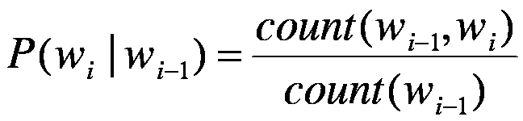
Estimating Bigram Probabilities

Slide 14
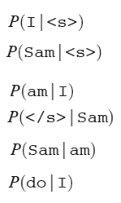
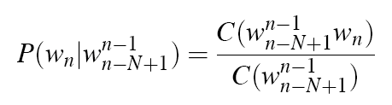
An Example: Using a mini corpus of three sentences
Introduce <s> - bigram context of the first word
Introduce </s> - end symbol
<s> I am Sam </s>
<s> Sam I am </s>
<s> I do not like green eggs and ham </s>

Slide 15


Slide 16
Maximum Likelihood Estimates
The maximum likelihood estimate of some parameter of a model M from a training set T is the estimate that maximizes the likelihood of the training set T given the model M
Suppose the word “Chinese” occurs 400 times in a corpus of a million words (Brown corpus)
What is the probability that a random word from some other text from the same distribution will be “Chinese”
MLE estimate is 400/1000000 = .0004
  This may be a bad estimate for some other corpus
It is the estimate that makes it most likely that “Chinese” will occur 400 times in a million word Brown corpus.

Slide 17
Berkeley Restaurant Project Sentences
can you tell me about any good cantonese restaurants close by
mid priced thai food is what i’m looking for
tell me about chez panisse
can you give me a listing of the kinds of food that are available
i’m looking for a good place to eat breakfast
when is caffe venezia open during the day
…….
……..

Slide 18
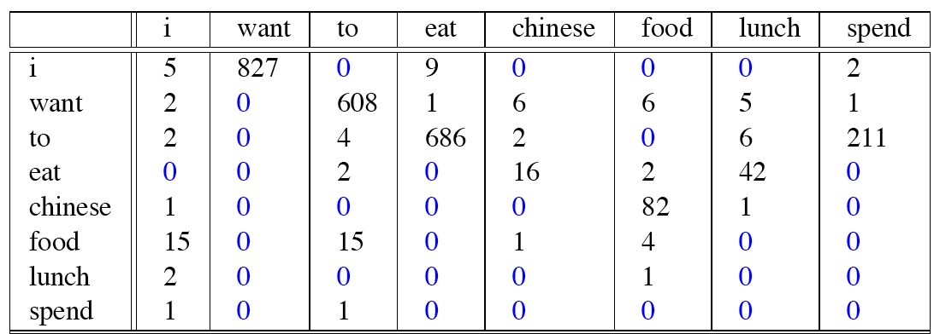
Bigram Counts and Unigram counts
Out of 9222 sentences
  Eg. “I want” occurred 827 times

Slide 19
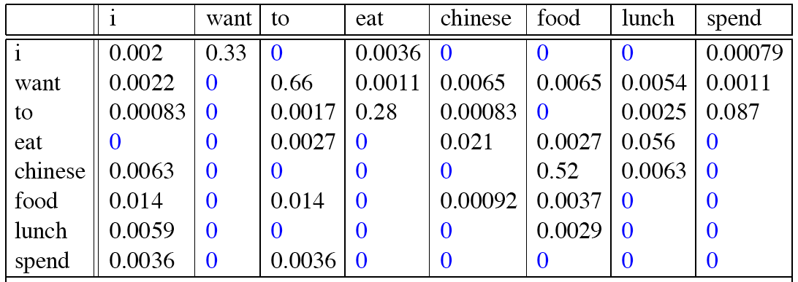
Bigram Probabilities
Divide bigram counts by prefix unigram counts to get probabilities.

Slide 20
Bigram Estimates of Sentence Probabilities
<s> I 0.25
I want 0.32
want to 0.65
to eat 0.26
eat British 0.02
British food 0.60
P(I want to eat British food)

Slide 21
P(I want to eat British food) =
P(i|<s>) P(want|I) P(to|want)P(eat|to)P(British|eat) P(food|British)
= 0.000016

Slide 22
N-grams Issues
Sparse data
  Not all N-grams found in training data, need smoothing
Change of domain
  Train on WSJ, attempt to identify Shakespeare – won’t work
    Generating Shakespeare sentences with random unigrams...
      Every enter now severally so, let
    With bigrams...
      What means, sir. I confess she? then all sorts, he is trim, captain.
    Trigrams
      Sweet prince, Falstaff shall die.

Slide 23
Smoothing Techniques
Every N-gram training matrix is sparse, even for very large corpora (Zipf’s law )
Solution: estimate the likelihood of unseen N-grams

Slide 24
Add-one Smoothing
  Add 1 to every N-gram count
P(w_{n}|w_{n-1}) = C(w_{n-1}w_{n})/C(w_{n-1})
P(w_{n}|w_{n-1}) = [C(w_{n-1}w_{n}) + 1] / [C(w_{n-1}) + V]

Slide 25
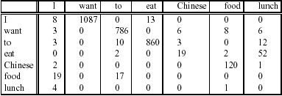
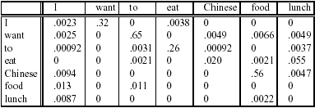
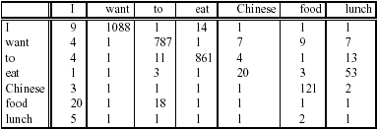
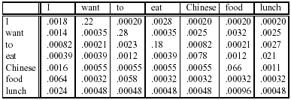
Add-one Smoothed Bigrams
P(w_{n}|w_{n-1}) = C(w_{n-1}w_{n})/C(w_{n-1})
P′(w_{n}|w_{n-1}) = [C(w_{n-1}w_{n})+1]/[C(w_{n-1})+V]

Slide 26
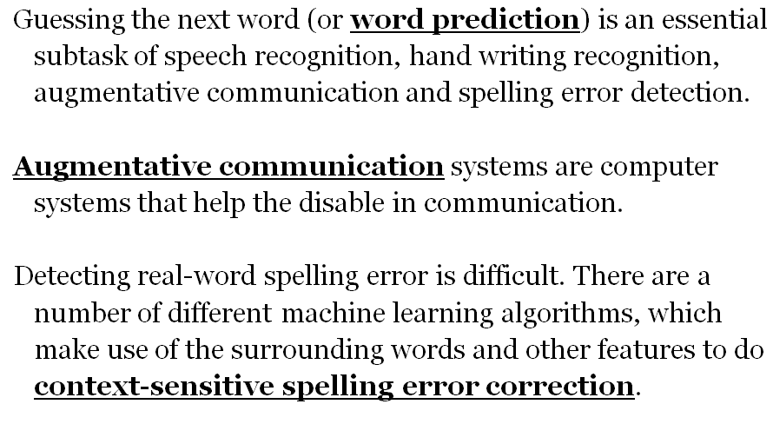
Applications

